Slide 1

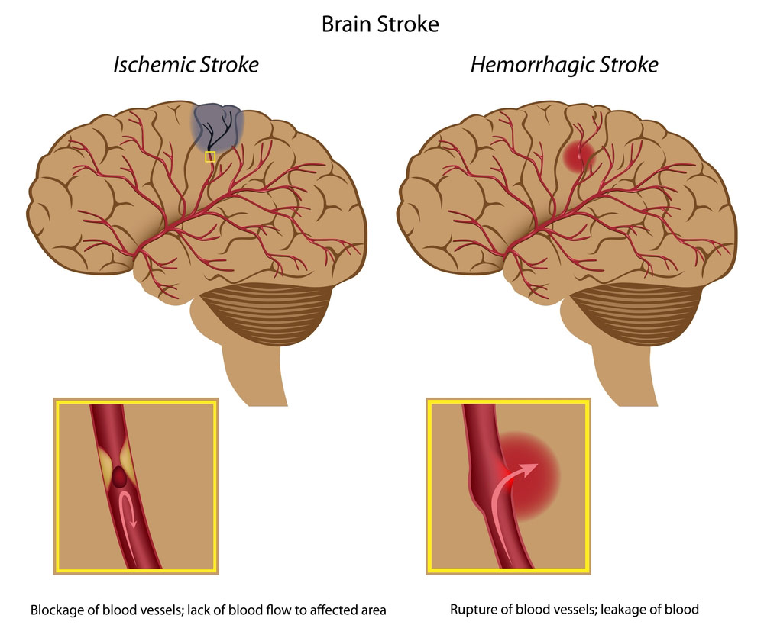
A stroke happens when blood flow to the brain is interrupted.

