Slide 1

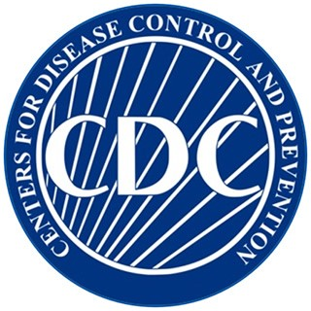
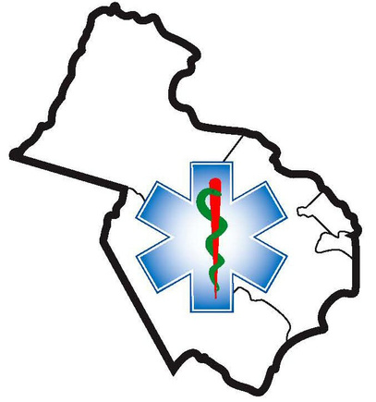

Stroke Smart
Basics
Presented by the Northern Virginia EMS Council

Slide 2

1 in 6 of us will suffer a stroke in our lifetime
Someone in the U.S. suffers a stroke every 40 seconds
Someone dies every 4 minute from stroke
2 million brain cells die every minute during a stroke
Notes:
The odds get higher as we age, but anyone can have a stroke at any time.

Slide 3
The Good News: Definitive treatment is available!
Getting to the ER within 3 hours can save a life!
Most people don’t get to treatment in time
Notes:
We have the medicine to drastically reduce the death and extreme disability that comes with strokes. You can avoid that tragedy for yourselves and others from acting on this simple information presented here today.

Slide 4
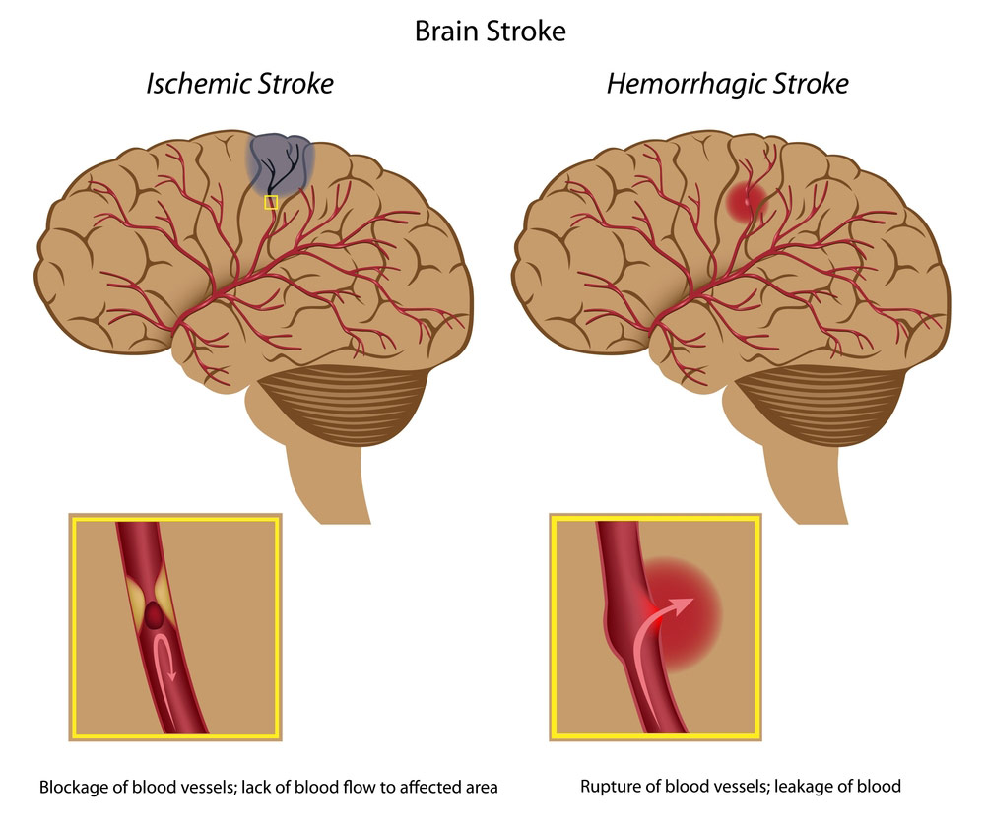
What is a Stroke?
Blood interruption to the brain
Notes:
A stroke occurs when blood flow to brain cells is interrupted. Blood flow can be interrupted when a vessel bursts and when a blockage occurs in a blood vessel. The symptoms of both are similar as blood is interrupted to the cells past the break or blockage.

Slide 5
The Goal
1) Spot a Stroke
2) Stop a Stroke
3) Save a Life
Notes:
You will leave here today with the knowledge and confidence to spot a stroke, stop a stroke, and save a life.

Slide 6
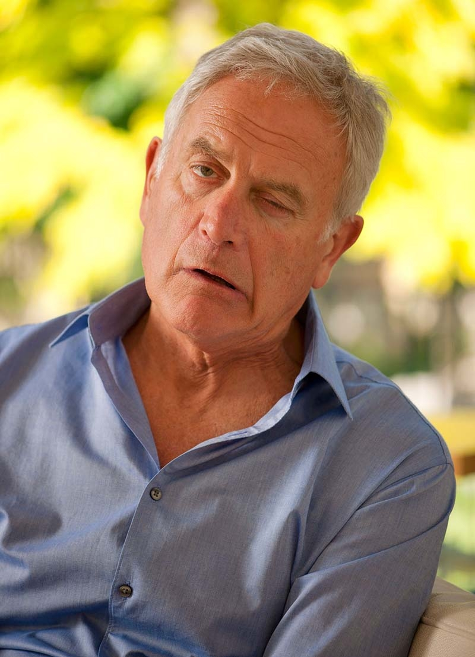
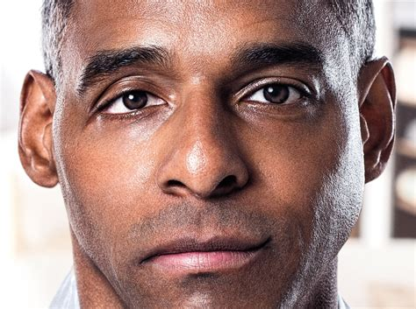
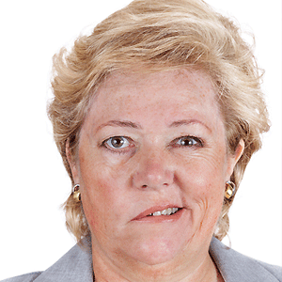
Spot a Stroke
Notes:
Roughly 70% of stroke patients will show a droopy face or one-sided arm weakness. These people are unable to smile with both sides of their faces due to the stroke. If they get to treatment in time, their chances of quick recovery are most likely.

Slide 7
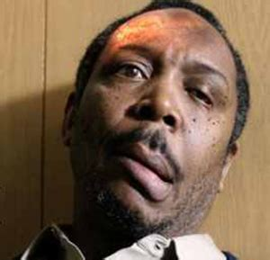
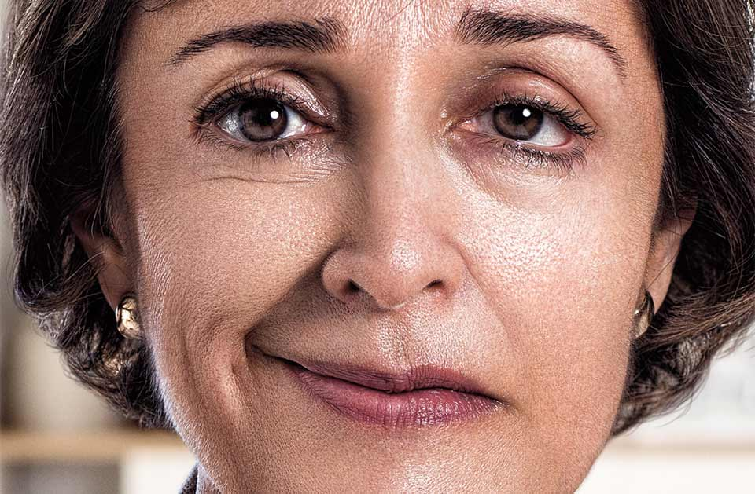
Spot a Stroke

Slide 8
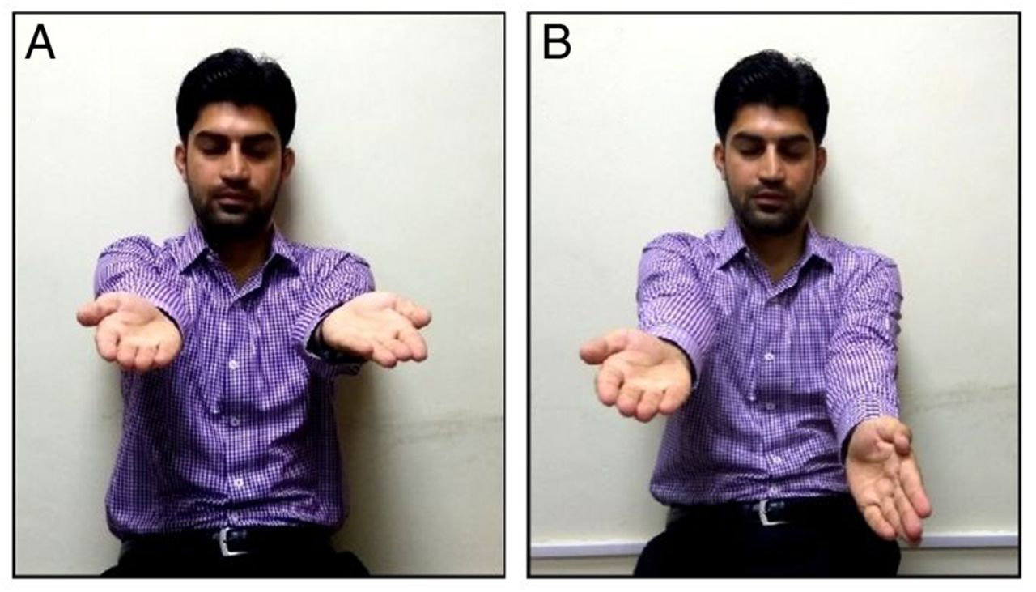
Spot a Stroke
Notes:
This is the 2nd common sign most people suffering from strokes will have. They are often unable to raise both arms to the same level. One side is suddenly weak without a known reason. They may even think they are raising both arms equally. Not all stroke patients will show this sign, however.

Slide 9
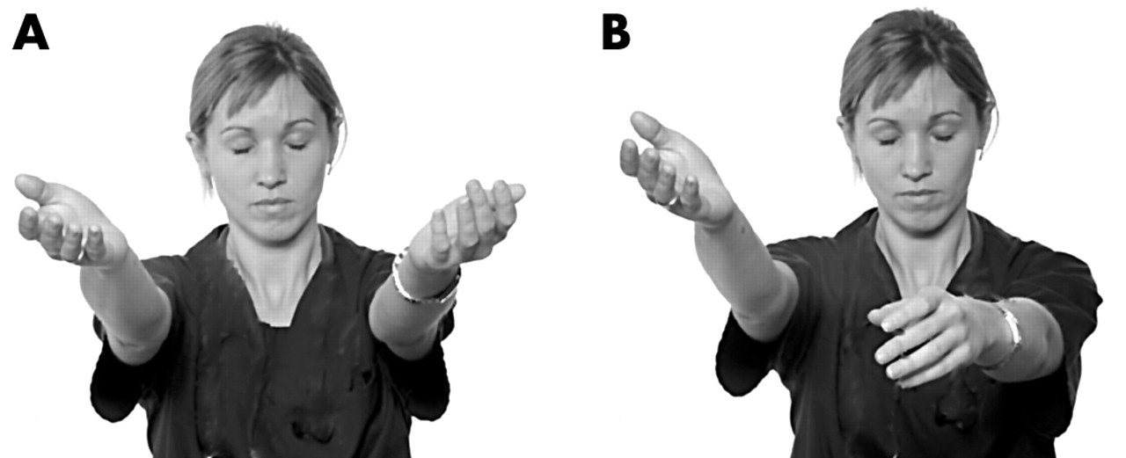
Spot a Stroke

Slide 10
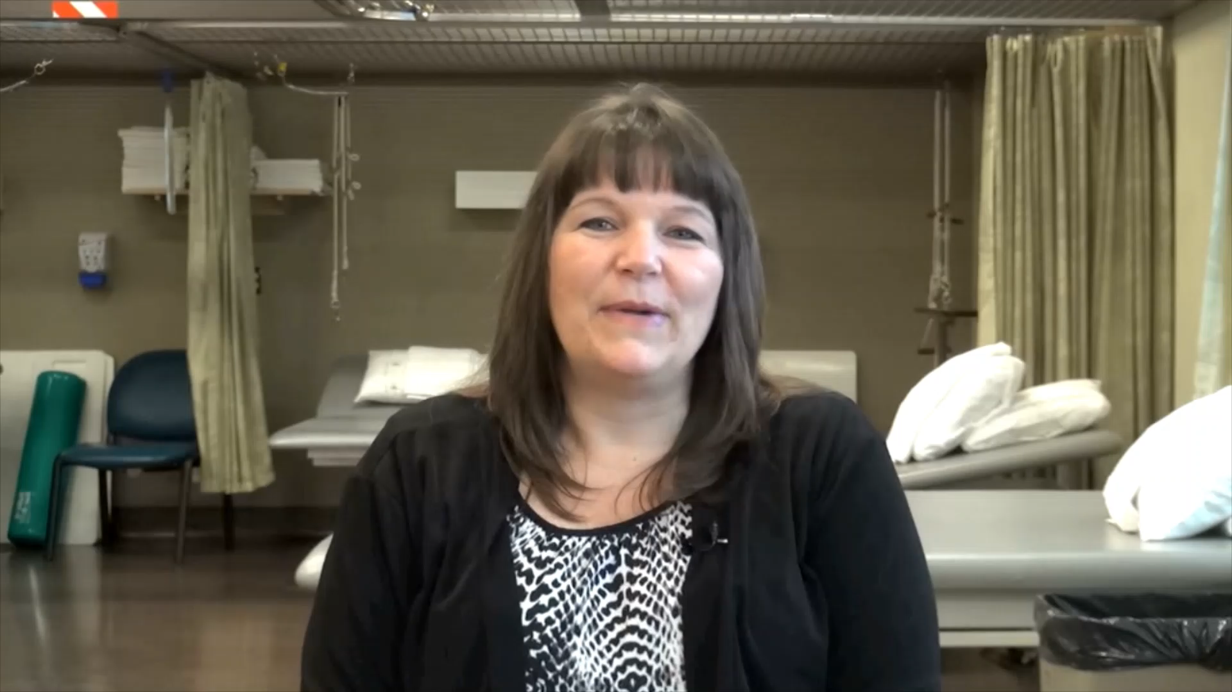
Video Goes Here
Notes:
Stacy needed rehab. The goal of this talk is to ensure you get to definitive treatment in time, lessening your chances of needing rehab!

Slide 11
Spot a Stroke
Sudden, Unexplained Signs
Numbness on one or both sides of the body
Difficulty understanding or forming words
Loss of balance/dizziness
Confusion
Weakness on one or both sides of the body
Vision Changes
Facial Drooping
Notes:
Sudden, unexplained onset. Symptoms can come and go.

Slide 12
The Goal
1) Spot a Stroke
2) Stop a Stroke
3) Save a Life
Notes:
Once you suspect the person might be having a stroke, you MUST take action to stop that stroke.

Slide 13
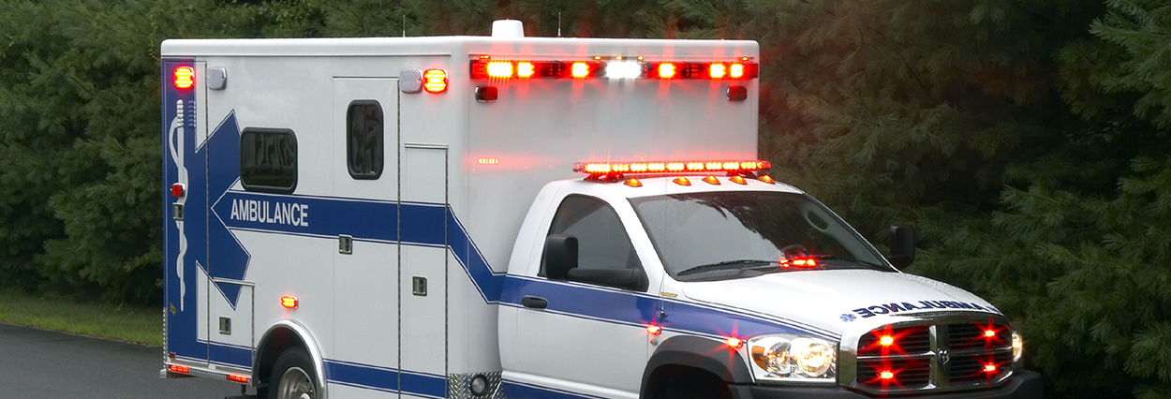
Stop a Stroke
Do Call 911!
Don’t drive yourself to the ER
Don’t call your primary doctor
Don’t lie down thinking it will pass
Notes:
Calling 911 is the fastest way to get the stroke patient to life saving treatment.

Slide 14
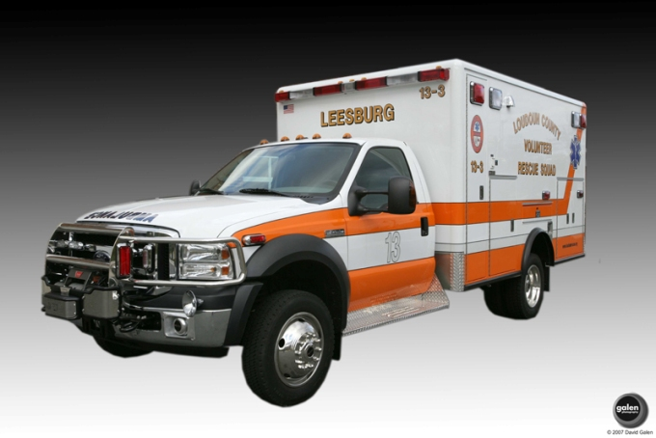
Stop a Stroke
There is no cost for just calling 911
Many stroke patients can’t call 911 themselves
The cost of not calling 911 with a stroke is much higher
Notes:
The ambulance personnel do not get mad at you for calling them. It’s their job to respond.

Slide 15
The Goal
1) Spot a Stroke
2) Stop a Stroke
3) Save a Life
Notes:
Your action has the potential to drastically reduce disability and to save a life.

Slide 16

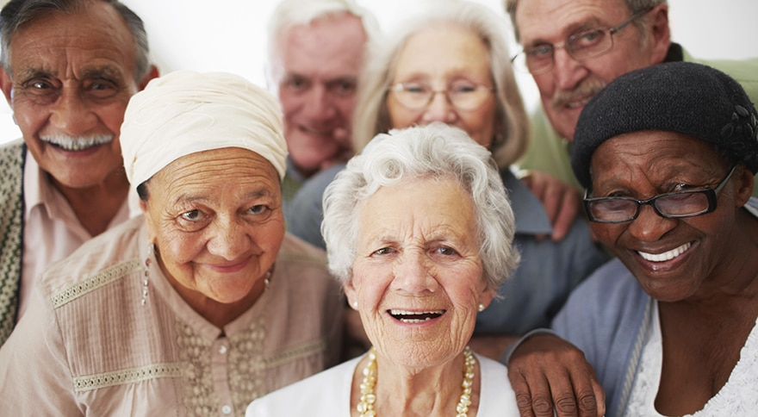
Save a Life
Norway study: 6 years, 613 patients
73 received treatment within 1 hour of symptoms
100% had ZERO deficits (no weakness, speech issues, etc.)
Notes:
Stacy needed rehab. The goal of this talk is to ensure you get to definitive treatment in time, lessening your chances of needing rehab!

Slide 17
The Goal
1) Spot a Stroke
2) Stop a Stroke
3) Save a Life
Notes:
To summarize, you leave here today with the knowledge and confidence to spot a stroke, stop a stroke and save a life.

Slide 18
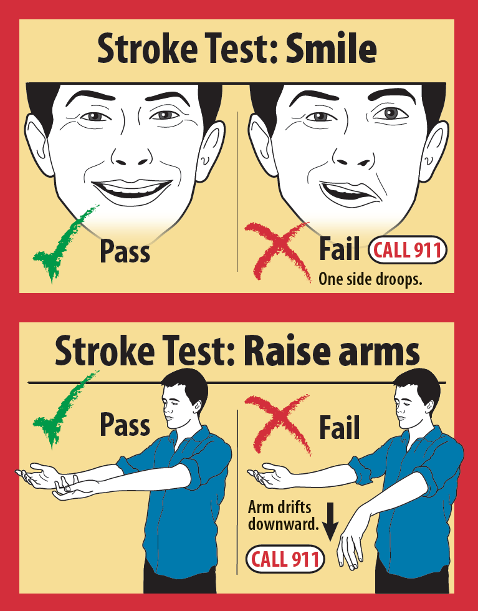
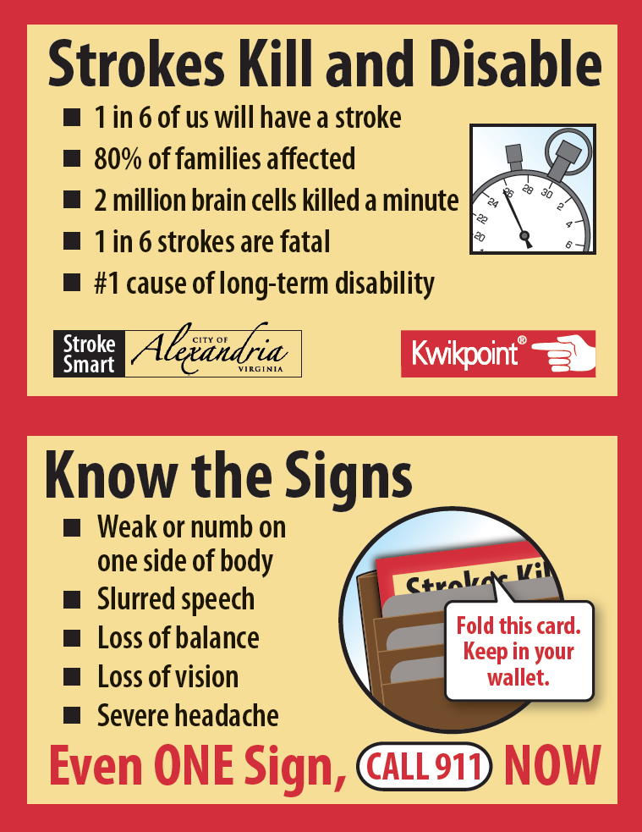
Notes:
Your gift today from the CDC and VDH, who encourages you to offer your neighbors and friends this simple, easy guidance of how to spot as stroke, stop a stroke and save a life. Extra magnets and wallet cards are available. If each of you tells just one person, you will make a difference.

